Slide 1
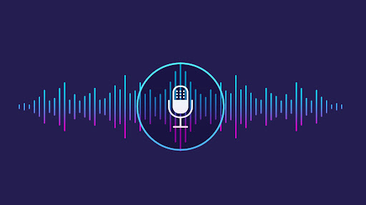
PYTHON DESKTOP ASSISTANT
BY
YASH DAMLE

Slide 2
WHAT IS VOICE ASSISTANT?
Voice Assistant is a software agent that can perform tasks or services for an individual based on commands or questions.
It is able to interpret human speech and respond via synthesized voices.
Users can ask their assistants questions, media playback via voice, and manage other basic tasks such as email, to-do lists, and calendars with verbal commands.

Slide 3
FEATURES
Tells news and jokes
Opens a set of applications installed on computer
Opens a set of websites
Searches on Google and Wikipedia
Visits Instagram profiles and downloads the profile picture
Tells current time and date

Slide 4
WHY TO USE THIS ?
Easy to use
Helpful for the differently-abled people
Can work with variety of commands
Flexibility
Time saved with increased efficiency
Multitasking – dictation on the go

Slide 5
TECH STACK
This project is based on Python language
The compiling is done using Jupyter Notebook
This project mainly uses ‘pyttsx’ speech to text recognition module
Variety of python libraries are used smartly

Slide 6
HOW IT WORKS

Slide 7
THANK YOU

